Slide 1
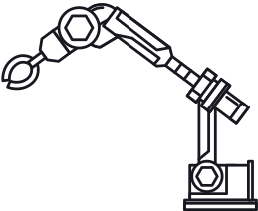


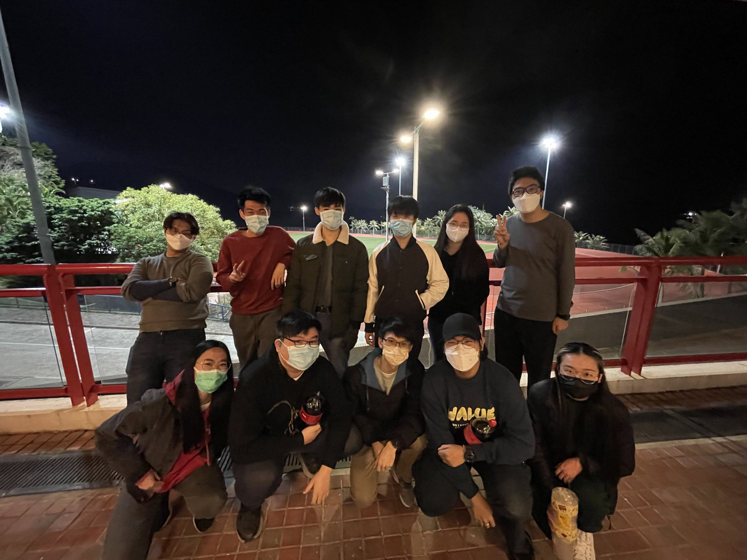
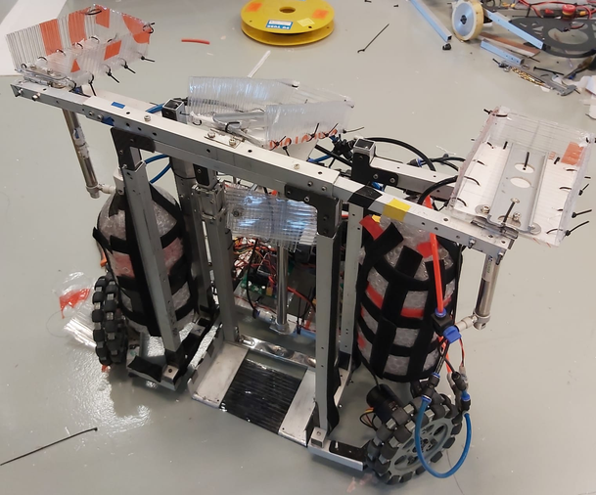
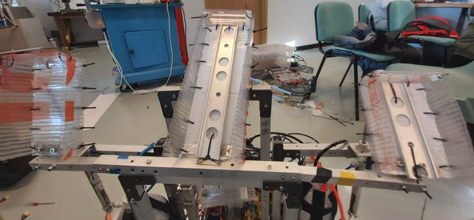
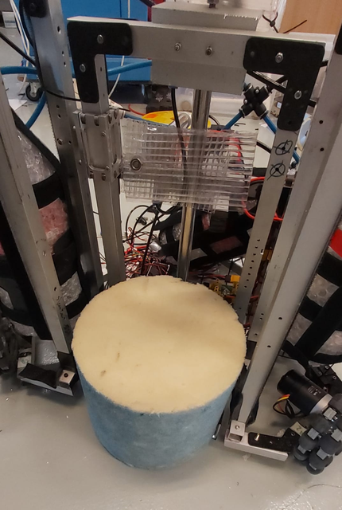
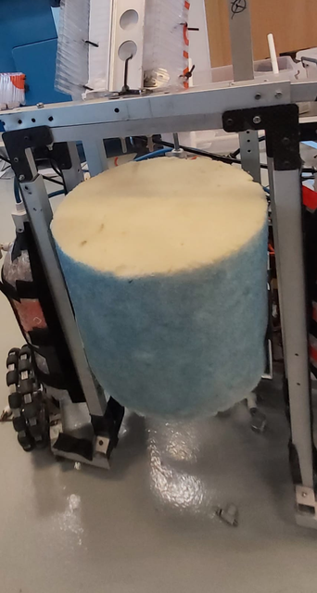
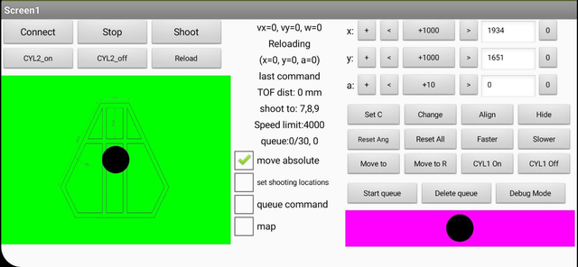
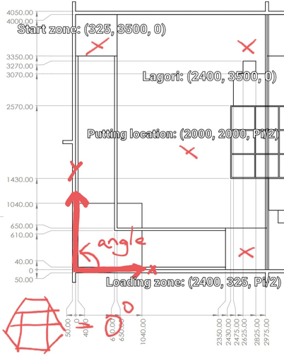
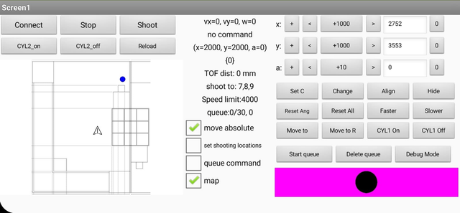
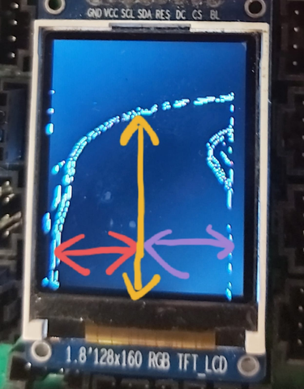
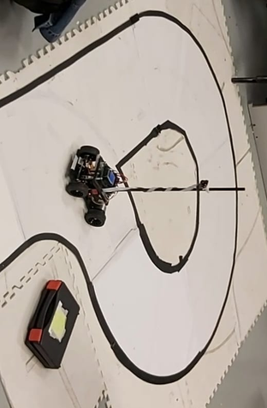

Group 5
F B TI S
Robot Design Contest
ABSTRACT
WE ARE FIBOTICS! Our team comprises 12 members, each with distinctive skills from prior experiences or simply freshmen who share enthusiasm in robotics. "Fibotics" is inspired by group number 5, and, more importantly, we all love robotics! We are honoured to participate in Robot Design Contest (RDC) 2022 to design and build the automatic racing car (ARC) and Task Robot (TR) to solve the tic-tac-toe challenge precisely and other competitive challenges! In the following, allow us to elaborate on our robot design mechanism and our compelling journey.
Task Robot (TR)
Dropping Mechanism
TR have three separate rails of different lengths to hold and drop the pieces to the tic-tac-toe boxes. The rails are connected by hinges separately and are initially slanted backwards to avoid the pieces from rolling out. Three respective pneumatic cylinders will push the rails upwards to slant forward the rails so that the pieces roll down along the rails and into the box.
Loading Mechanism
OUR TEAM
We have racks installed at the loading zone. Once the TR arrives at the loading zone, it will hit the handle of the loading racks to trigger a passive loading mechanism, releasing the pieces onto the TR's built-in rack per rail, and hold firmly by the -45 degree setting of the rail.
TEAM MEMBERS
Lagori Task Solution
Dicaprio
Tyler
Curtis
Timmy
Martin
Philip
Ga Young
Gigi
Fiona
Jonathan
Leo
Nicky
Software
Software
Software
Software
Hardware
Hardware
Hardware
Hardware
Hardware
Mechanics
Mechanics
Mechanics
Year 2
Year 1
Year 2
Year 1
Year 2
Year 1
Year 1
Year 3
Year 3
Year 1
Year 2
Year 2
CPEG
SENG
MATH
SENG
CPEG
SENG
SENG
ELEC
PHYS
SENG
MECH
MECH
We have a sweeper-lifter connected to the back of the TR robot and an initially extended pneumatic cylinder. The sweeper sweeps the Lagori into the lifter, and when the pneumatic cylinder retracts, the lifter will be at a height above the Lagori base, whereas TR will move towards the base to drop the Lagori. A horizontal cylinder is attached at the back to strike as an additional force to push Lagori firmly onto the Lagori base.
Game Strategy
TR's wheelbase calculates the distance from the walls and measure arrival at the tic-tac-toe area. Once the wheelbase is aligned fully with the area, the pneumatic cylinder pushes the rails over 90 degrees. Rails become slanted, and pieces are released to the tic-tac-toe boxes. The pieces are released separately by different pneumatic cylinder control to perform one at a time. The rails return to the initial state once the pneumatic cylinder retracts.
INSTRUCTED BY:
Jeffrey
Samson
Woody
Sam
Software
Hardware
Hardware
Mechanics
Robocon
Robocon
Humanoid
Robocon
Bluetooth Command System
We implemented a large number of commands on TR for many different situations. E.g. moving, shooting, moving along the auto shortcut, move to specific locations, We even add a queue to store multiple commands so that we can execute a list of commands automatically without manual controlling the TR.
TEAM EVALUATION
Move Coordinate System
Overall Experience and Strength of our team
We calculate the TR's x, y, and angle coordinates using the motor speed returned from CAN. Using this system, we can easily move to the desired location with the correct angle by clicking the exact same location on the map. The location coordinates of our TR will also be sent and shown on the map. There will be some accumulated errors after every move, so we use a TOF sensor and wall alignment strategy to reset the robot's coordinates and ensure it is accurate again.
Our members are outstandingly creative and hardworking. The members had extraordinary ideas for different tasks for the competition. Even with the wheels from the start, our various ideas may have led to changes in plans, but the hard-working members eventually made it work.
Automatic Racing Car (ARC)
Areas for improvement
We need to improve our communication between different departments. It would be better to have all members of all teams up to date with the progress of different departments.
Division of labor could be improved as the work often relied on few of the strong members of the department.
We should not trust the things mentioned by our mentors such that we are over-confident of our abilities and mechanisms. We should test it out ourselves in an early stage to avoid wasting time.
Image Processing
We used a Sobel filter to filter out unwanted data on the image to do Track sensing more easily. We found out that filtering the whole image is time-consuming and meaningless. So we only filter out the pixels that we need to improve the frame rate of the ARC. (The image on the right is for testing purposes only, we won't filter out the whole image when moving.)
Track Sensing
ACKNOWLEDGEMENTS
The ARC mainly calculates two things: the distance between the track's centre to the left and right borders and how far it is from the edge in the front. The ARC will adjust the correct steering angle using the PID algorithm and senses a turn beforehand, then decelerate and drift through it accordingly. Moreover, it also counts the number of turns to know whether it should follow the right or left border.
We, as a team, would like to extend our gratitude towards all mentors, PIC, senior members and staff for their support, guidance and training. Despite the chaos due to COVID-19 cases, we are grateful to have been able to continue in the journey safely.

